Slide 1
Getting Started
Join the MdPHA Advocacy Committee
Get on the email lists of organizations and legislators doing work that you support, and follow them on social media. Ask for opportunities to volunteer if you have capacity.
Know your legislators: https://mgaleg.maryland.gov/mgawebsite/Members/District
Familiarize yourself with the Maryland General Assembly website
Read local newspapers

Slide 2
The Six Steps for Effective Advocacy
Transforming Public Will Into Political Power:
Stephanie Klapper, Deputy Director Maryland Health Care for All! Coalition

Slide 3
Maryland Health Care for All! Coalition
Who we are: The Maryland Health Care for All! Coalition is a consumer health advocacy organization working to ensure that all Marylanders have access to quality, affordable health care. We are the largest and most diverse coalition of health care consumers in the state.
Current priorities include expanding access to health coverage, implementing the Health Equity Resource Act, and supporting the work of the Maryland Prescription Drug Affordability Board. More information about these initiatives can be found at www.healthcareforall.com

Slide 4
The Six Steps to Effective Advocacy

Slide 5
The Six Steps to Effective Advocacy

Slide 6
Step One: Create an Evidence Based Plan

Slide 7
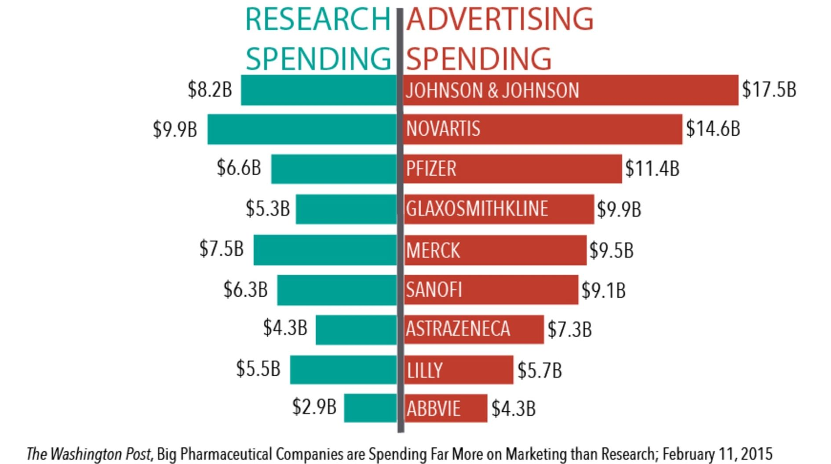
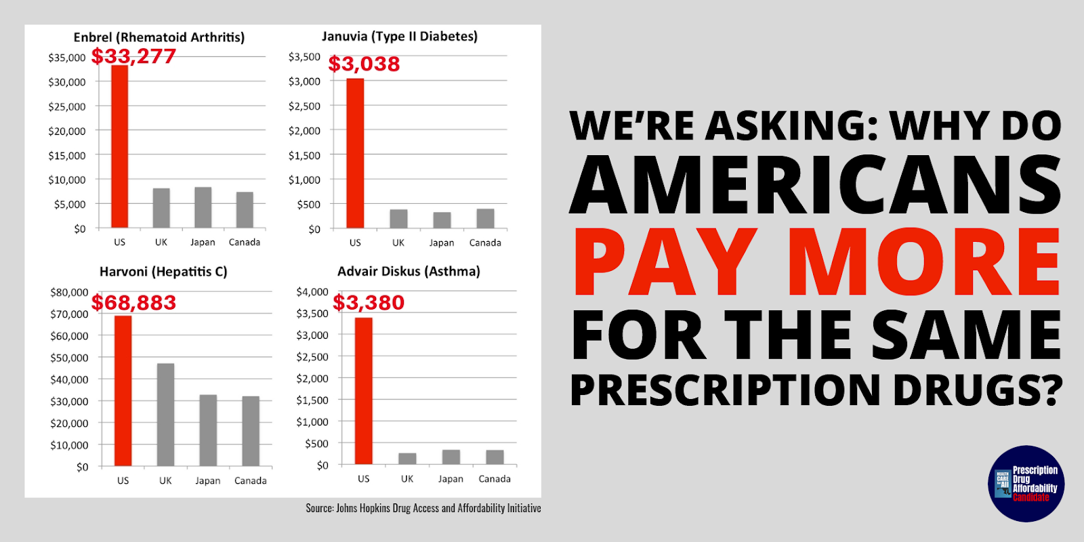
Americans pay more for their prescription drugs than any other developed country in the world.
The biggest driver of prescription drug costs is price increases on existing medications, not new drugs entering the market.

Slide 8
What is a Prescription Drug Affordability Board?

Slide 9
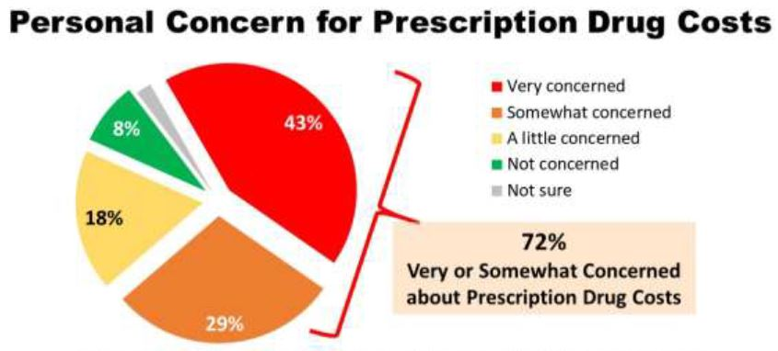
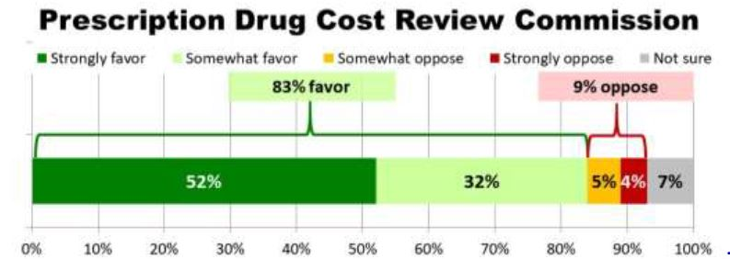
Step Two: Commission Polling
Establish public interest, show support for your proposal, and demonstrate that it will move voters.

Slide 10
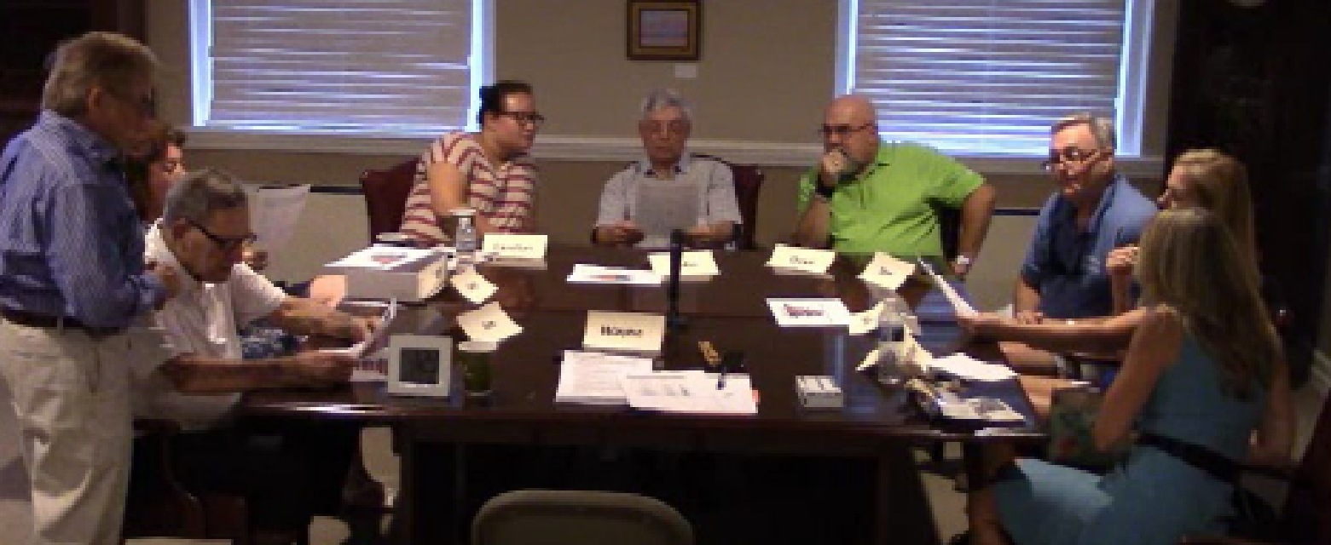
Hold focus groups to help improve your messaging.

Slide 11
Step Three: Build a Coalition
Create a diverse coalition that includes faith, community, labor, and business organizations.
Create a one-page resolution that explains the problem and the solution.

Slide 12
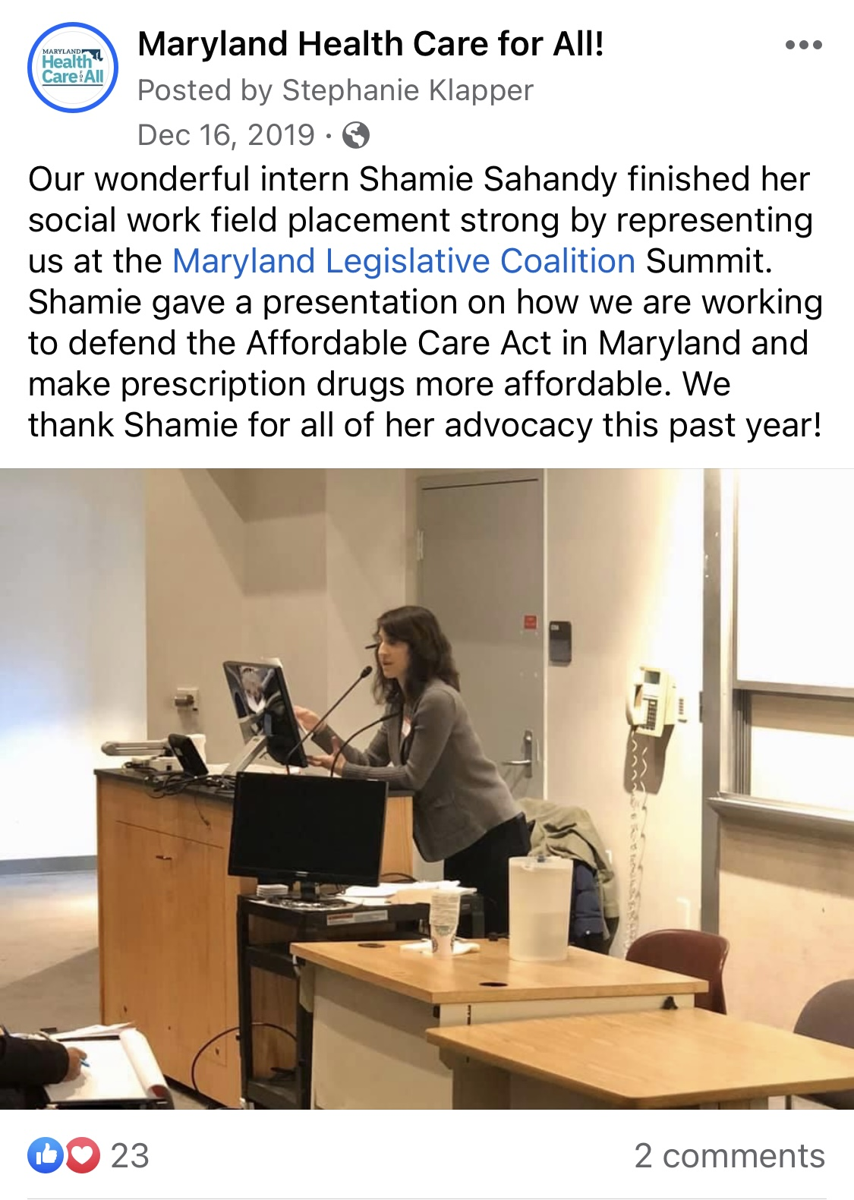

Slide 13
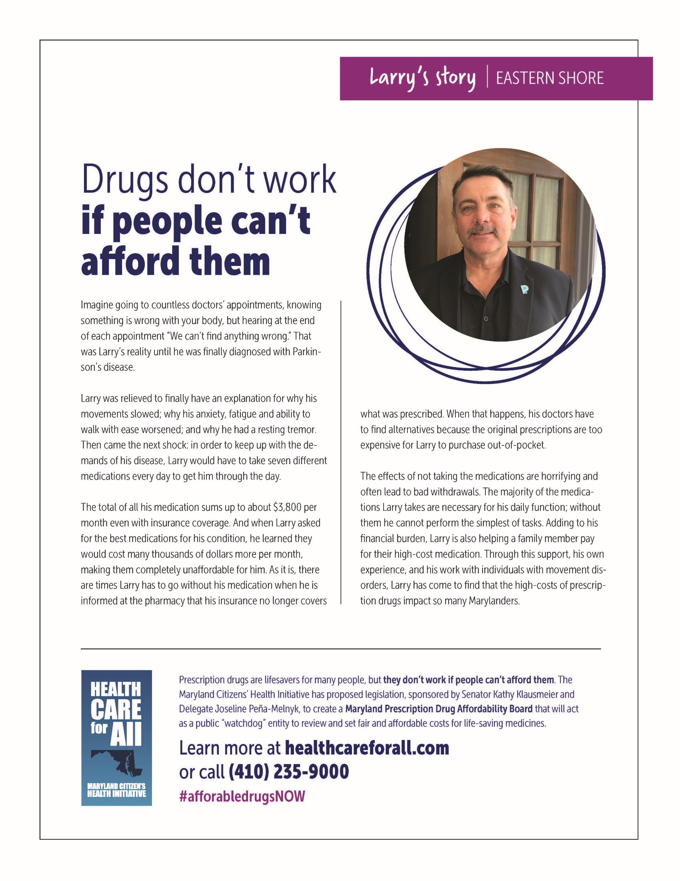
Elevate patient stories

Slide 14
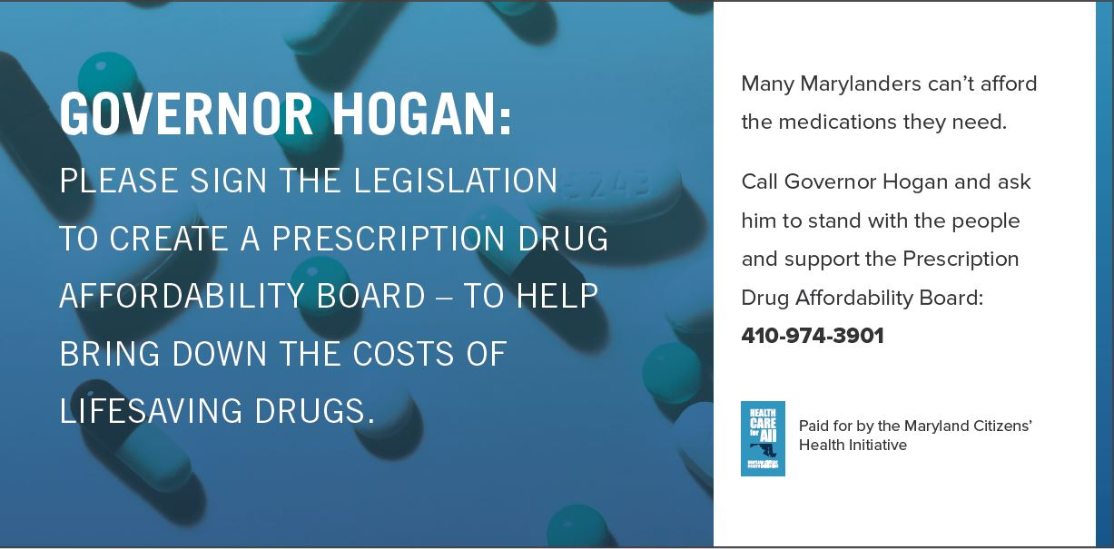
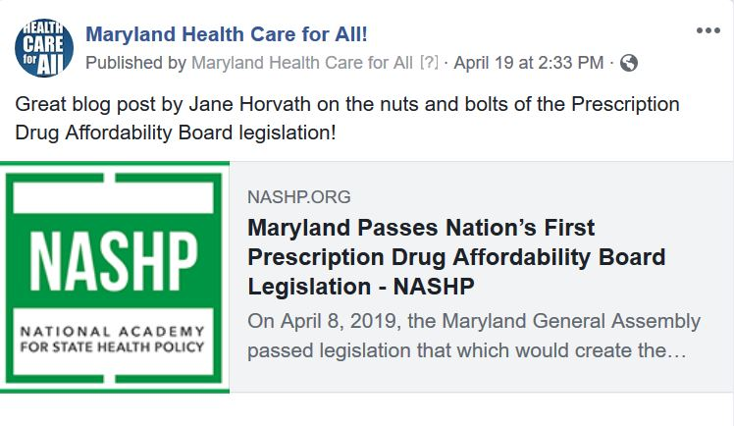
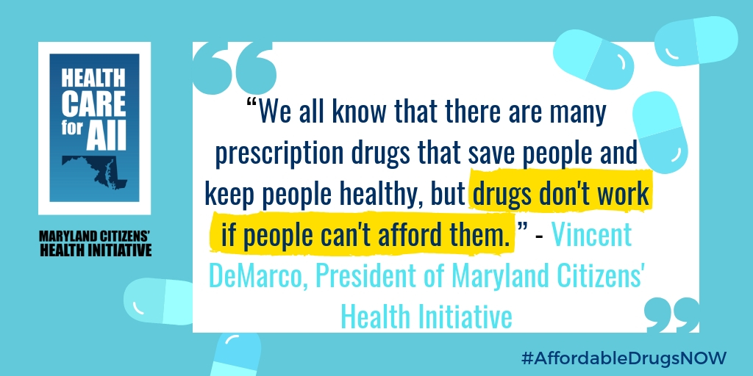
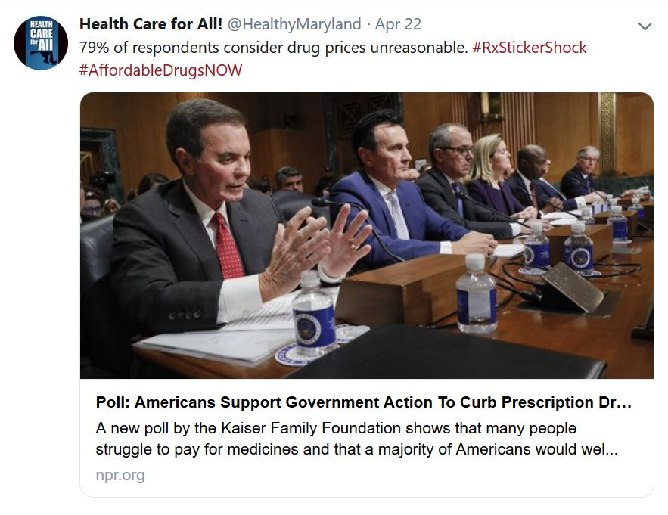
Paid Media Earned Media Social Media
Step Four:
Utilize the Media
Maryland weighs new approach to curbing prescription drug costs
Doctor:
high drug pricing
kills patients
Faith Leaders Urge Creating Board to
Review Drug Costs

Slide 15
@HealthyMaryland
@mdhealthcareforall
@marylandhealthcareforall
healthcareforall.com

Slide 16
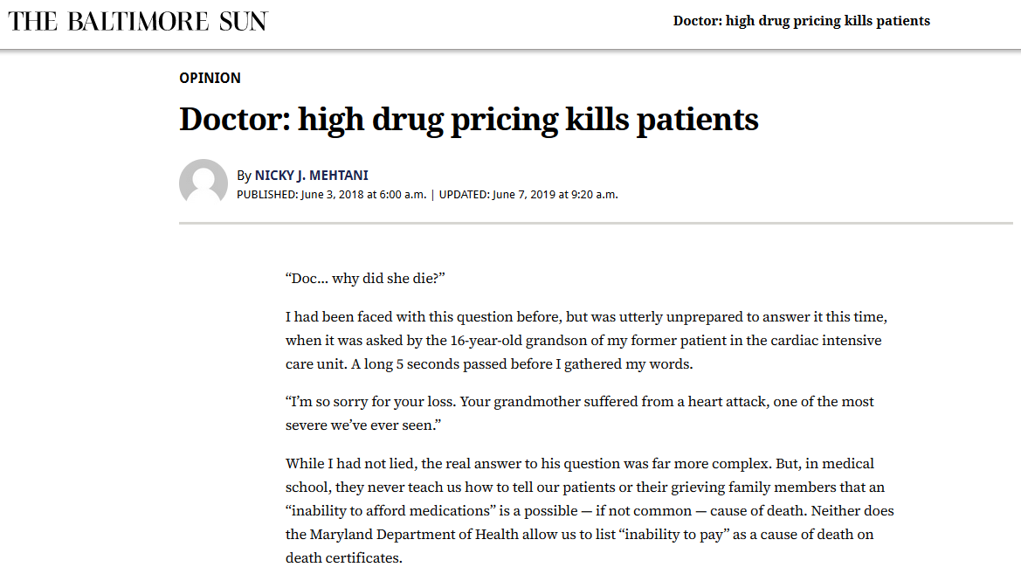

Slide 17
Write a Letter to the Editor
Write to a local paper
Clearly state your position
Describe how public health research supports your position
Be 175-300 words
Can support a bill, oppose a bill, or provide public education about a public health opportunity that already exists (e.g. open enrollment for health coverage)

Slide 18
Utilize social media
Highlight the stories of patients and the posts of organizations whose work you support
Take pictures and videos at advocacy events and post them personally and/or send them to the organization working on the issue
During the legislative session, follow the relevant hashtags on X (for example, #mdga23, #mga23, #mdga2023, #mga2023)
Ask your networks to contact their legislators at key moments during the advocacy campaign

Slide 19
Step Five: Make it an Election Issue
Turn your resolution into one for candidates – use a 501(c)4

Slide 21
Step Six: Win in the Legislature

Slide 23
The Legislative Session - 2024
Runs from January 10 to April 8
Senate bills must be introduced by Feb. 5, House by Feb. 9
Crossover is March 18. If a bill has not passed at least one chamber by this date, it is almost certainly not going to pass this session.
Bill hearings are typically Tuesdays, Wednesday, and Thursdays from 1PM until late afternoon to evening. To sign up to testify you must have a MyMGA account and sign up during a precise window ahead of the hearing.
Floor sessions are typically Monday evening, and mornings Tuesday-Friday.

Slide 25
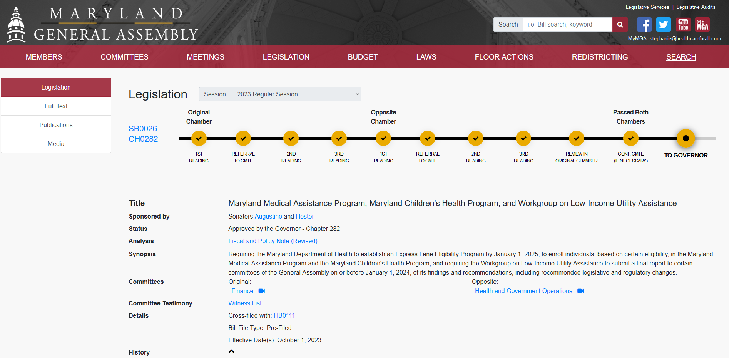

Slide 26
Ways to get involved
Draft written testimony for the MdPHA Advocacy Committee
Submit oral testimony for the MdPHA Advocacy Committee
Meet with or write to your legislators, especially if they are on a committee that will hold a hearing for the bill that interests you
Join an advocacy day
Amplify the issue to your networks
Teach your networks how to make their voices heard

Slide 27
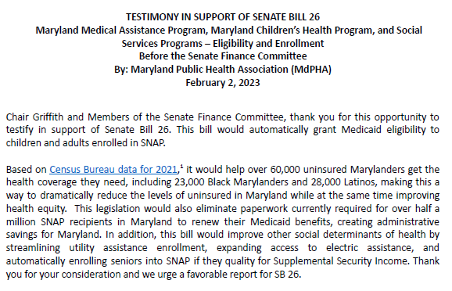
Written Testimony

Slide 28
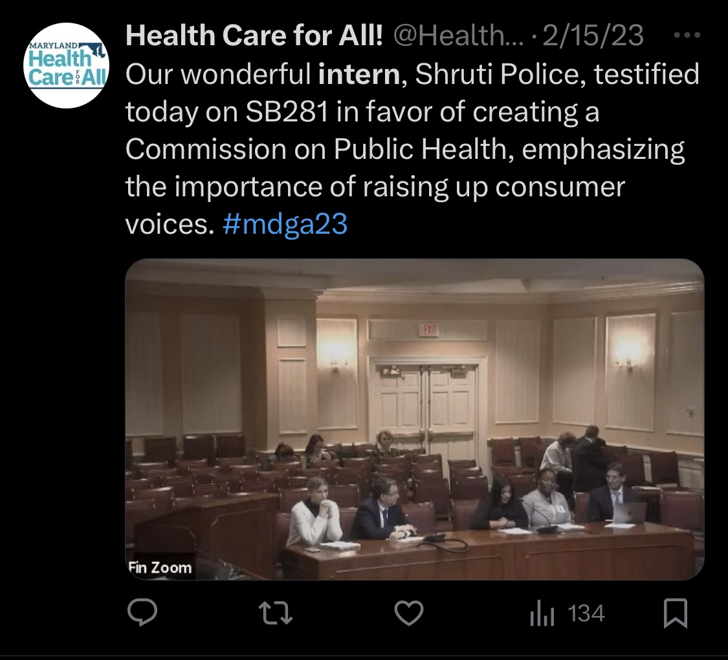

Slide 29
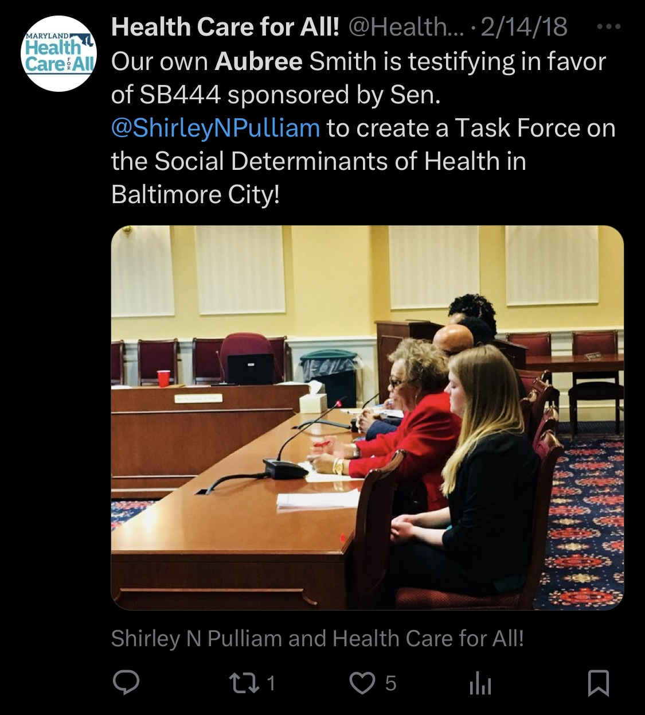

Slide 30
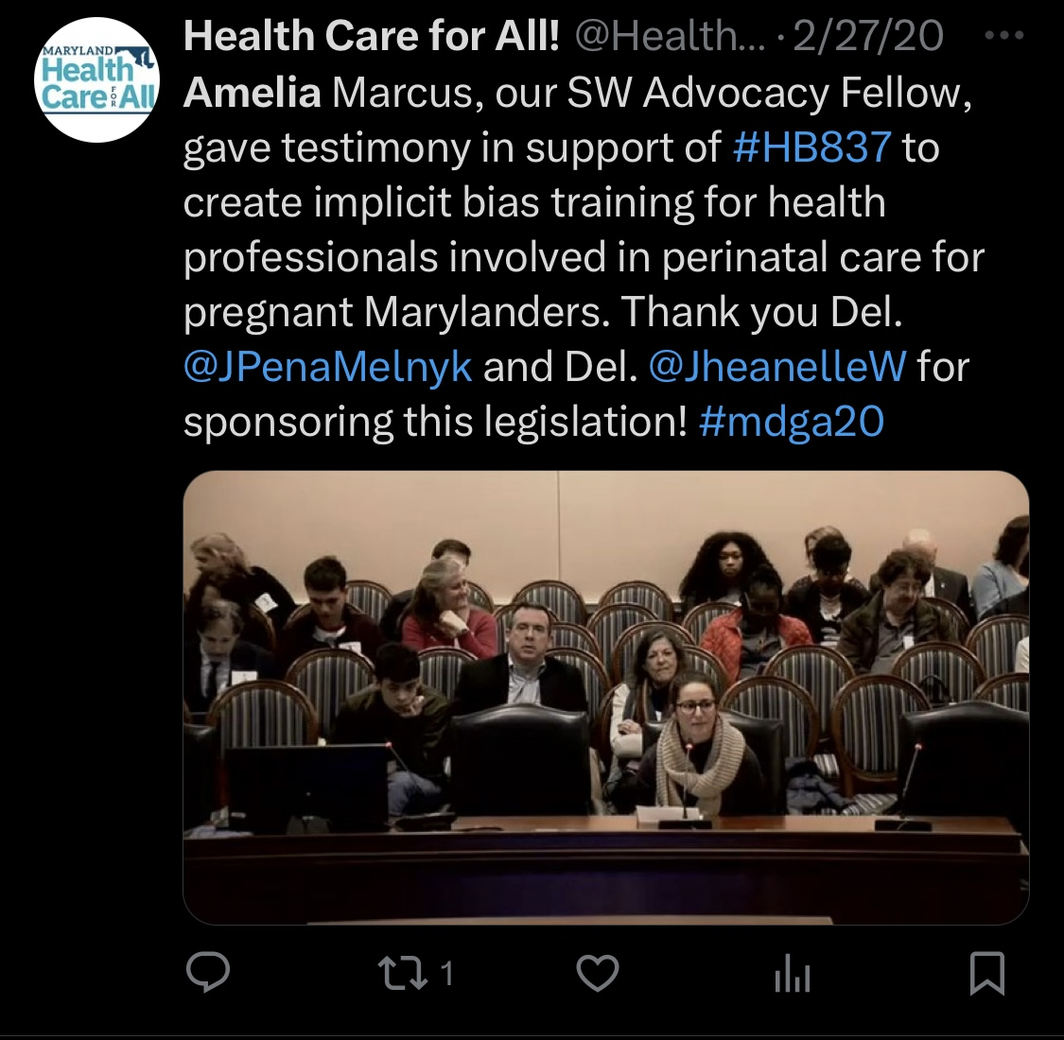

Slide 31
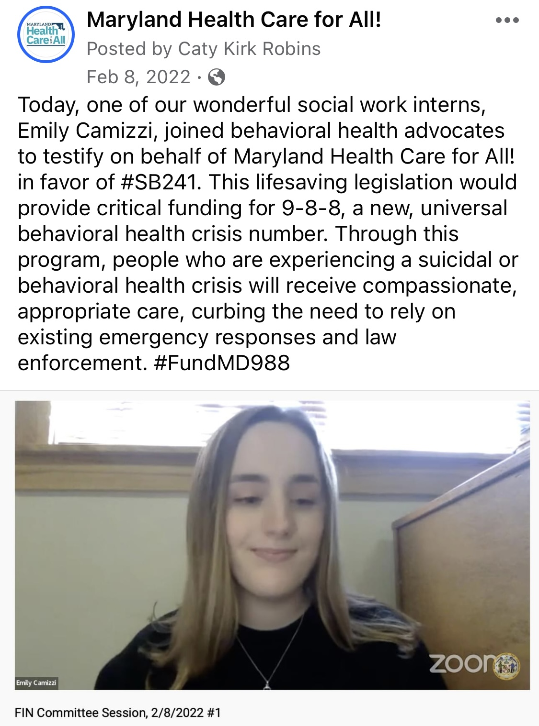

Slide 32
Example Email to Legislator
As your constituent, I have been so glad to see the work the General Assembly has done to begin addressing prescription drug affordability for Marylanders. In particular, I am thankful to have Maryland’s first-in-the-nation Prescription Drug Affordability Board (PDAB) serving as a watchdog for our state and keeping Maryland patients’ best interests at heart as they examine high-cost prescription drugs and determine ways to make them more affordable.
Despite this, too many of my friends and family still struggle to afford the medications they need. It is not fair that Marylanders are forced to skip doses, cut their pills in half, or leave a prescription at the pharmacy counter all while pharmaceutical corporations make record-breaking profits. Maryland’s PDAB is doing great work to examine this issue, but its current authority is limited to addressing costs for only state and local government entities. I am writing you today to urge you to support expanding this authority in 2024 so that the PDAB can set statewide upper payment limits.
It is critical that the PDAB is given the authority it needs to make expensive medications more affordable for all Marylanders, because drugs don’t work if people can’t afford them.

Slide 33
After you win, remember to:
Thank legislators and supporters
Work on implementation
Celebrate!

Slide 34
Questions?
www.healthcareforall.com
(410) 235-9000
stephanie@healthcareforall.com
X: @healthymaryland
Facebook.com/MDHealthCareForAll
Instagram: @MarylandHealthCareForAll

